Slide 1
Spotify Genre Classifier
By Harsha Malireddy

Slide 2
Problem
Spotify has about 40-60,000 new songs added to the platform everyday which makes it very difficult for the platform to manually label each and every track that is uploaded.
A solution to this is to use a machine learning genre classification model that can make predictions of the genre for each new track that is added.
By adding this tag based genre classification feature across all platforms (web, computer, mobile) that use Spotify, Spotify could potentially convert free users of the platform into paying premium users as user satisfaction could increase due to the added feature.
Free users might convert to premium users as they find Spotify to be the platform that offers the best and largest number of features to customize their listening experience.

Slide 3
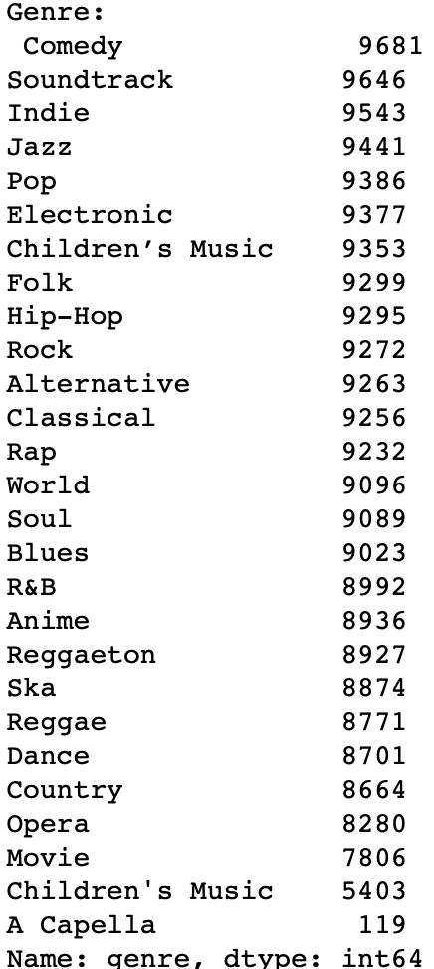
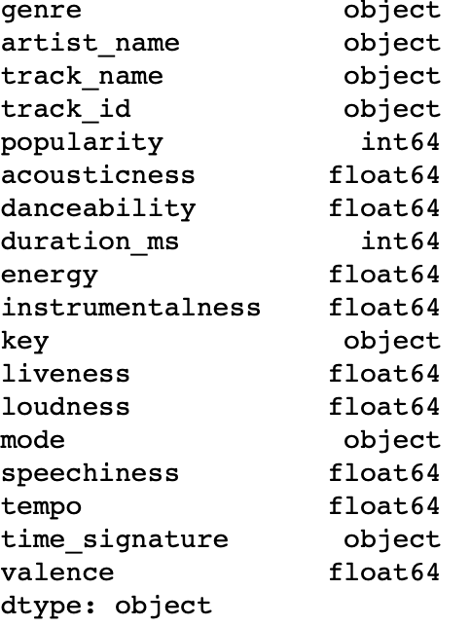
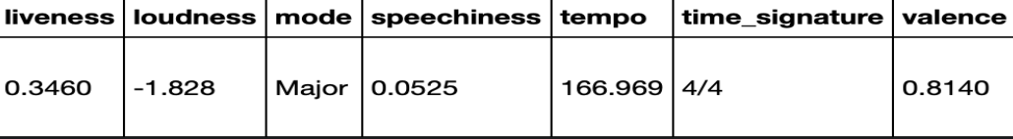
Data
Kaggle Dataset: https://www.kaggle.com/zaheenhamidani/ultimate-spotify-tracks-db
232,725 tracks, 18 columns, 26 genres
7 categorical: genre, artist_name, track_name, track_id, key, mode, time_signature
11 numerical: popularity, acousticness, danceability, duration_ms, energy, instrumentalness, liveness, loudness, speechiness, tempo, valence
Genre: There are 26 genres of music
Artist_name: Name of artist, Track_name: Name of track, Track_id: ID of track
Key: ['D' 'C' 'F' 'B' 'E' 'G' 'G#' 'A#' 'C#' 'A' 'F#' 'D#']. The key or pitch the track is in
Mode: [Major, Minor]. Modality of track, the type of scale from which its melodic content is derived.
Time_signature: ['4/4' '3/4' '5/4' '1/4' '0/4']. An estimated overall time signature of a track. The time signature (meter) is a notational convention to specify how many beats are in each bar (or measure).
Popularity: Scale: [0, 100]. The popularity of the track with users on Spotify. 0 to 100 is an increase in popularity.
Acousticness: Scale: [0.0, 1.0]. A confidence measure from 0.0 to 1.0 of whether the track is acoustic. 1.0 represents high confidence the track is acoustic.
Danceability: Scale: [0.0, 1.0]. Danceability describes how suitable a track is for dancing based on a combination of musical elements including tempo, rhythm stability, beat strength, and overall regularity. A value of 0.0 is least danceable and 1.0 is most danceable.
Duration_ms: The duration of the track in milliseconds.
Energy: Scale: [0.0, 1.0]. It represents a perceptual measure of intensity and activity. Typically, energetic tracks feel fast, loud, and noisy.
Instrumentalness: Scale: [0.0, 1.0]. Predicts whether a track contains no vocals. “Ooh” and “aah” sounds are treated as instrumental in this context. Rap or spoken word tracks are clearly “vocal”. The closer the instrumentalness value is to 1.0, the greater likelihood the track contains no vocal content. Values above 0.5 are intended to represent instrumental tracks, but confidence is higher as the value approaches 1.0.
Liveliness: [0.0, 1.0]. Detects the presence of an audience in the recording. Higher liveness values represent an increased probability that the track was performed live. A value above 0.8 provides strong likelihood that the track is live.
Loudness: Scale: [-60, 0]. The overall loudness of a track in decibels (dB).
Speechiness: Scale: [0.0, 1.0]. Speechiness detects the presence of spoken words in a track. The more exclusively speech-like the recording (e.g. talk show, audio book, poetry), the closer to 1.0 the attribute value. Values above 0.66 describe tracks that are probably made entirely of spoken words. Values between 0.33 and 0.66 describe tracks that may contain both music and speech, either in sections or layered, including such cases as rap music. Values below 0.33 most likely represent music and other non-speech-like tracks.
Tempo: The overall estimated tempo of a track in beats per minute (BPM).
Valence: Scale: [0.0, 1.0]. Describes the musical positiveness conveyed by the track. High valence tracks sound more positive (e.g. happy, cheerful, euphoric), while tracks with low valence sound more negative (e.g. sad, depressed, angry).

Slide 4
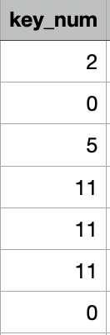
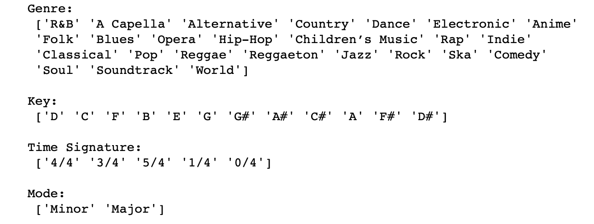
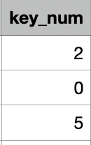
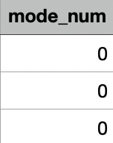
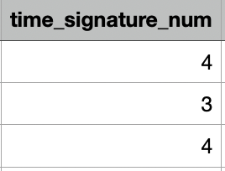
Data Wrangling
No null values nor duplicate rows.
I deleted the rows containing the ‘movie’ genre from the data set as I felt the label of ‘movie’ wasn’t a very useful or proper genre tag for which the model could classify on.
I combined the genre labels of “Children’s Music” and “Children’s Music” since the apostrophes in the data file for each of the labels was different, leading them to seen as different labels. I gave one specific apostrophe character for all of the ‘Children’s Music’ labels to solve this issue.
I converted 3 categorical columns (mode, key, time_signature) to numerical values by assigning integer values to each of the unique categorical values and then merged the numerical conversions into the dataset dataframe as additional columns.
Next, I eliminated any rows that classified the same song into more than one genre since I’m treating this as a multi classification problem and not as a multi-label classification problem. This elimination left only one row for each unique song that classifies it into one genre.
To do this, first I changed the artist name and track name columns to uppercase strings so no two same strings with different capitalizations would be treated as different tracks.
Then, I used the pandas ‘drop_duplicates()’ function with ‘track_id’ to find and drop rows with the same track id.
Lastly, I used ‘drop_duplicates()’ again but with the subset [‘artist_name’, ‘track_name]. This would identify identical songs that have the different ‘track_id’ values for reasons such as appearing in different albums, among others. These songs could be potentially classified into different genres and thus this final filtering ensures each unique track has one row and genre associated with it.
The result of all the filtering created a final data set of 152,864 tracks from the original 232,725 tracks.

Slide 5
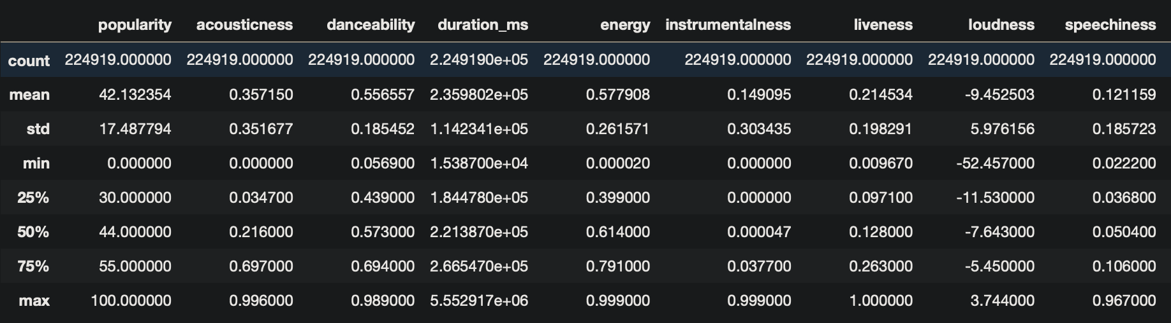
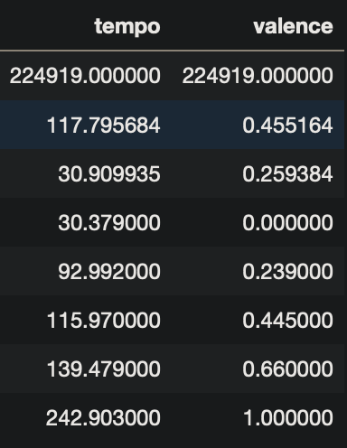
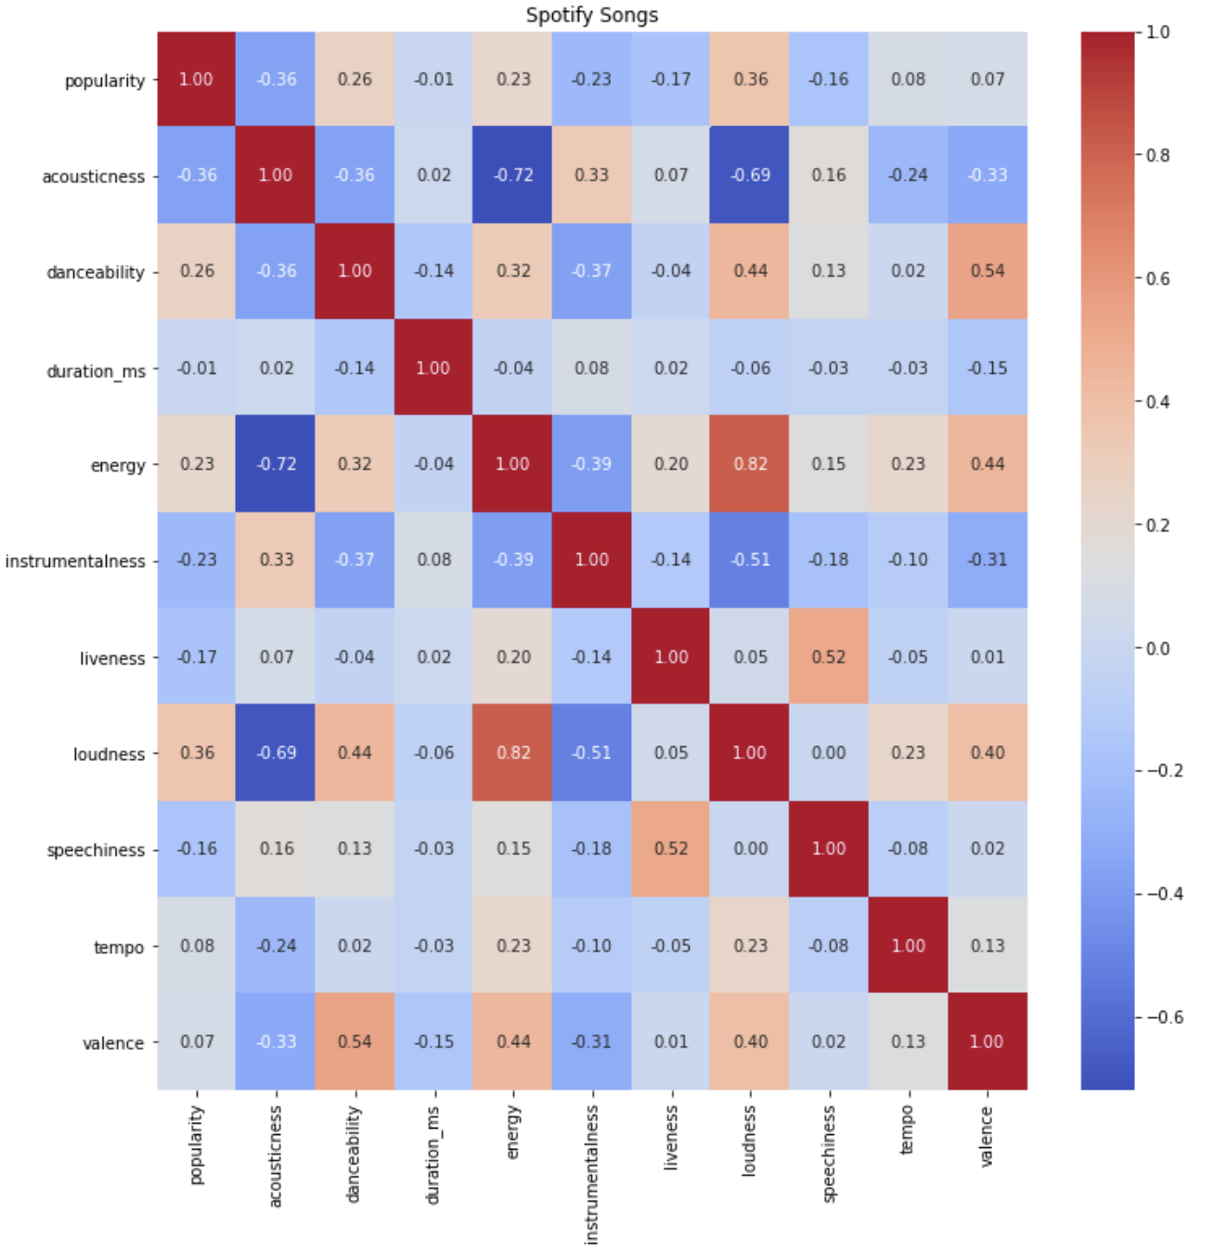
EDA
I plotted a seaborn correlation heatmap to understand the relationship between the 11 numerical attributes of a track.
I found that energy and loudness had a strong correlation.
I created a table to show the summary statistics of each of the attributes of a track.

Slide 6
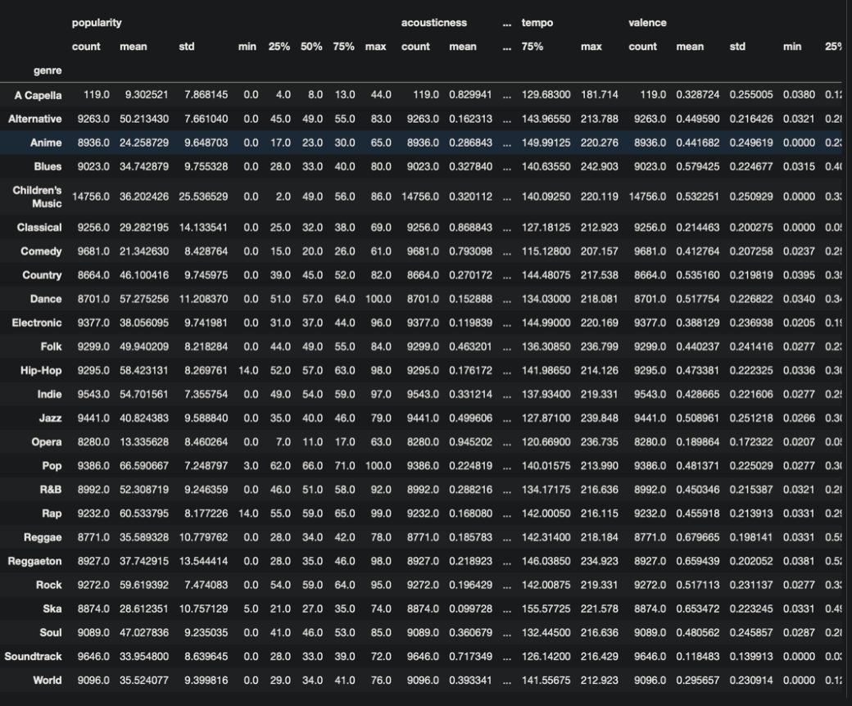
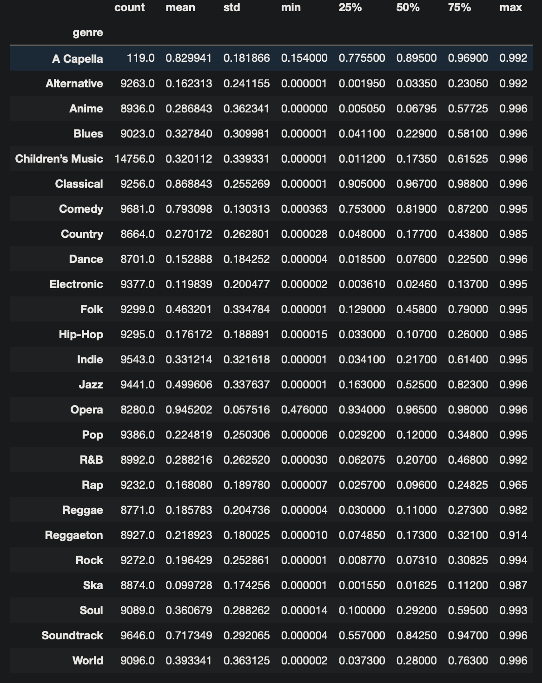
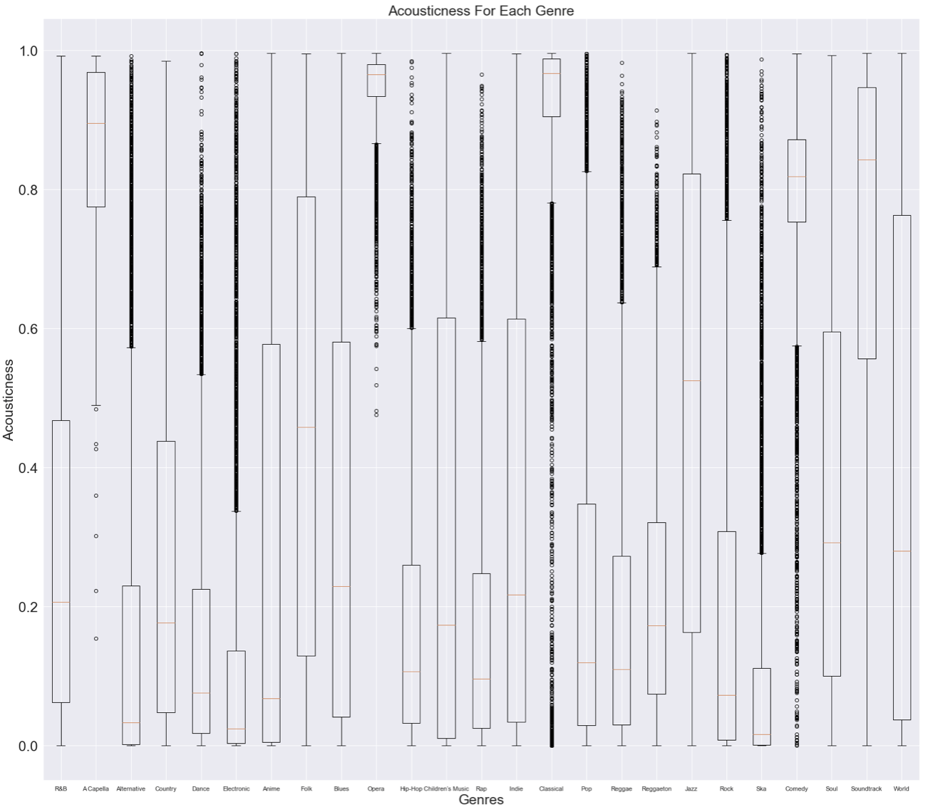
EDA
I created a table to show the summary statistics grouped by genre of each attribute of a track.
I displayed the summary statistics for each of the 9 important numerical features of a track for each genre: 'acousticness', 'danceability', 'energy', 'instrumentalness', 'liveness', 'loudness', 'speechiness', 'tempo', and 'valence.'
I plotted box plots grouped genre for each of the 9 important numerical features of a track for each genre: 'acousticness', 'danceability', 'energy', 'instrumentalness', 'liveness', 'loudness', 'speechiness', 'tempo', and 'valence.’
he data showed many outliers when grouped by each genre as seen in the box plots.

Slide 7
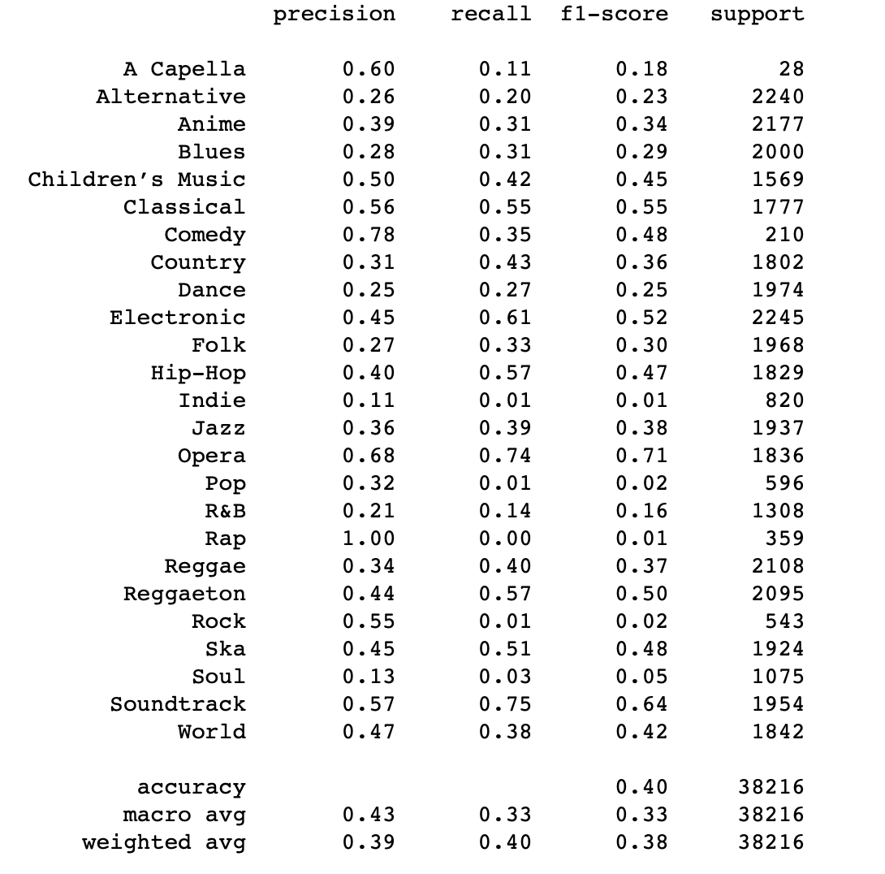
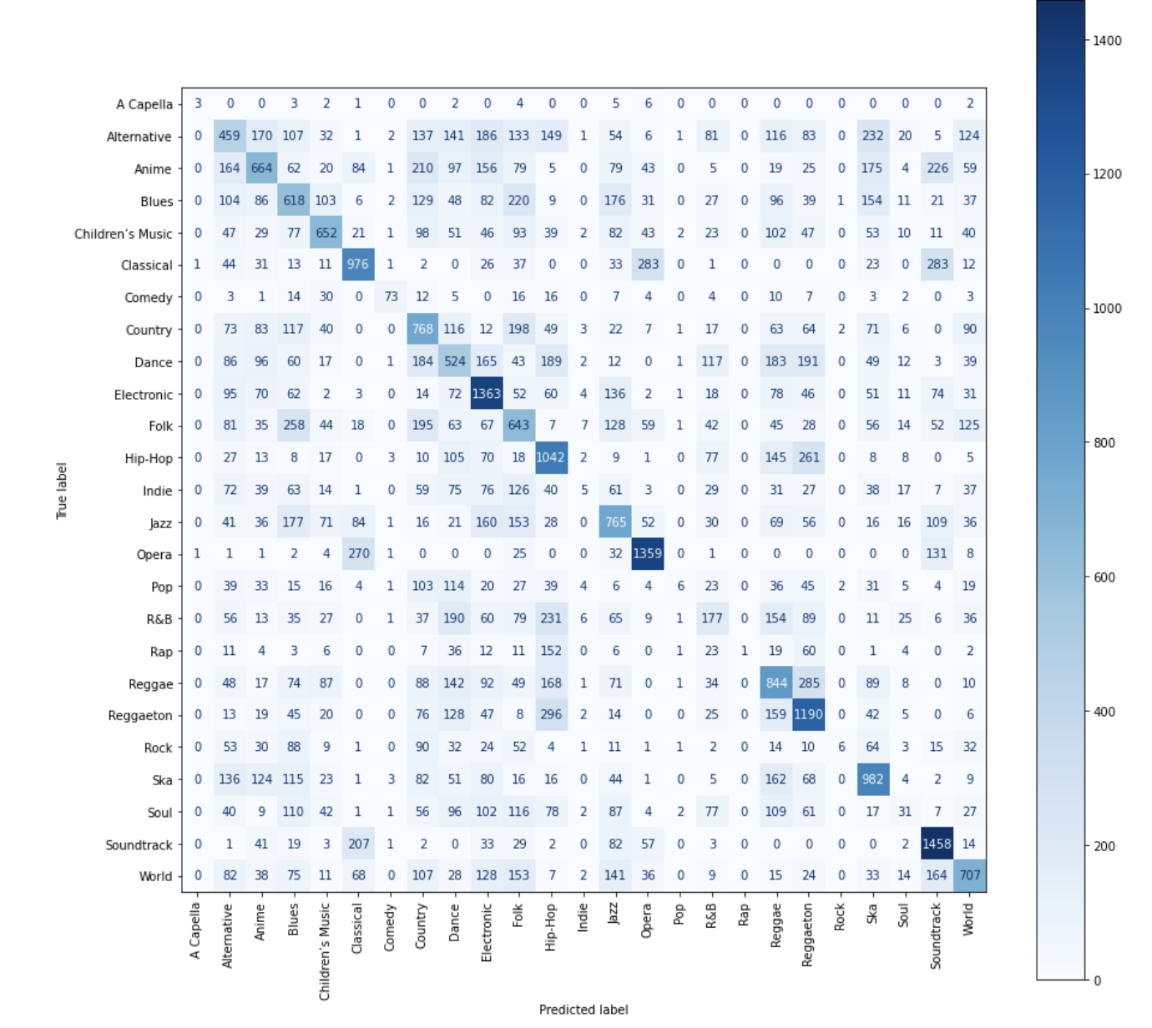
Modeling
I set the features that would be used to train the model to be the columns: ['acousticness', 'danceability', 'energy', 'instrumentalness', 'key_num', 'liveness', 'loudness', 'mode_num', 'speechiness', 'tempo', 'time_signature_num', 'valence'].
I removed outliers by finding the upper and lower bounds by (mean + cutoff (3 * std)) and (mean - cutoff (3 * std)) respectively.
I used the StandardScaler() method to fit and transform my training set and used the training set scaler on the testing set to avoid data leakage.
I trained and tested on 4 ML models: logistic regression (multinomial), Random Forest Classifier, Gradient Boosting Classifier, and Linear Support Vector Classifier.
I took the following 5 steps to implement each of the 4 ML models:
1. I used GridSearchCV for hyperparameter tuning to pick the best model version
2. I fit the model and madee predictions for the test set.
3. Printed the classification report displaying the accuracy, precision, recall, and F1-scores for each unique class variable (‘genre’).
4. Calculated the accuracy, precision, recall, F1-score, and log loss scores, and ROC-AUC (area under the curve) for the model.
5. Lastly, displayed the confusion matrix to see the distribution of predictions being made across all genres.
Classification Report
Confusion Matrix

Slide 8
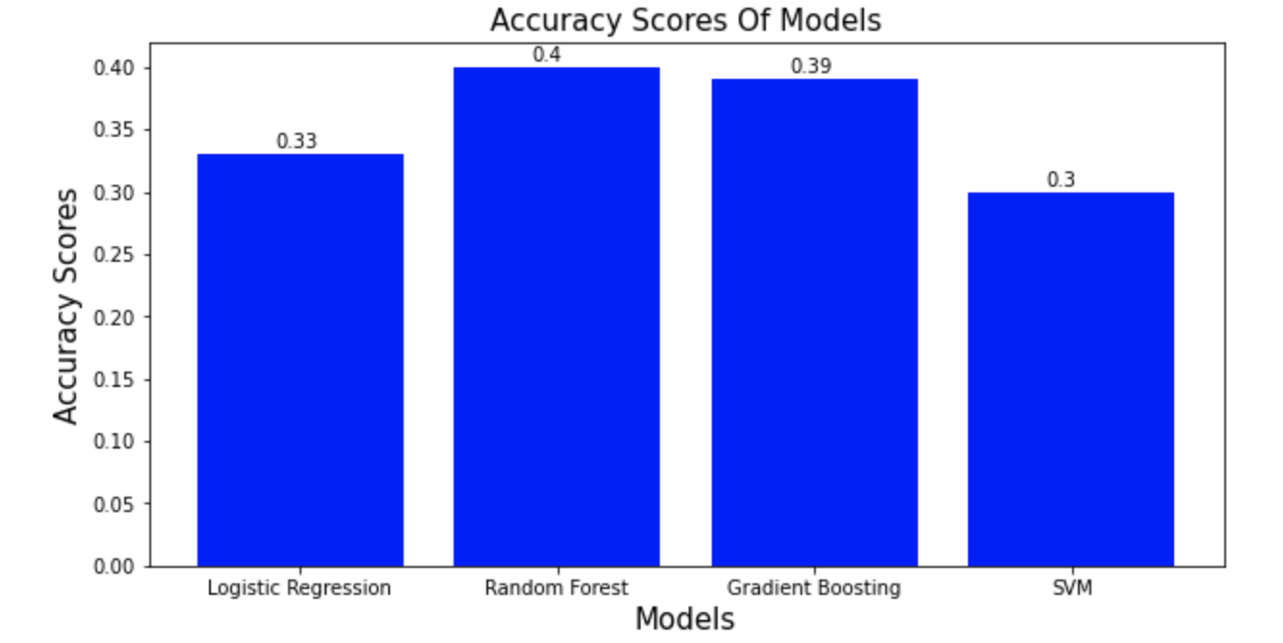
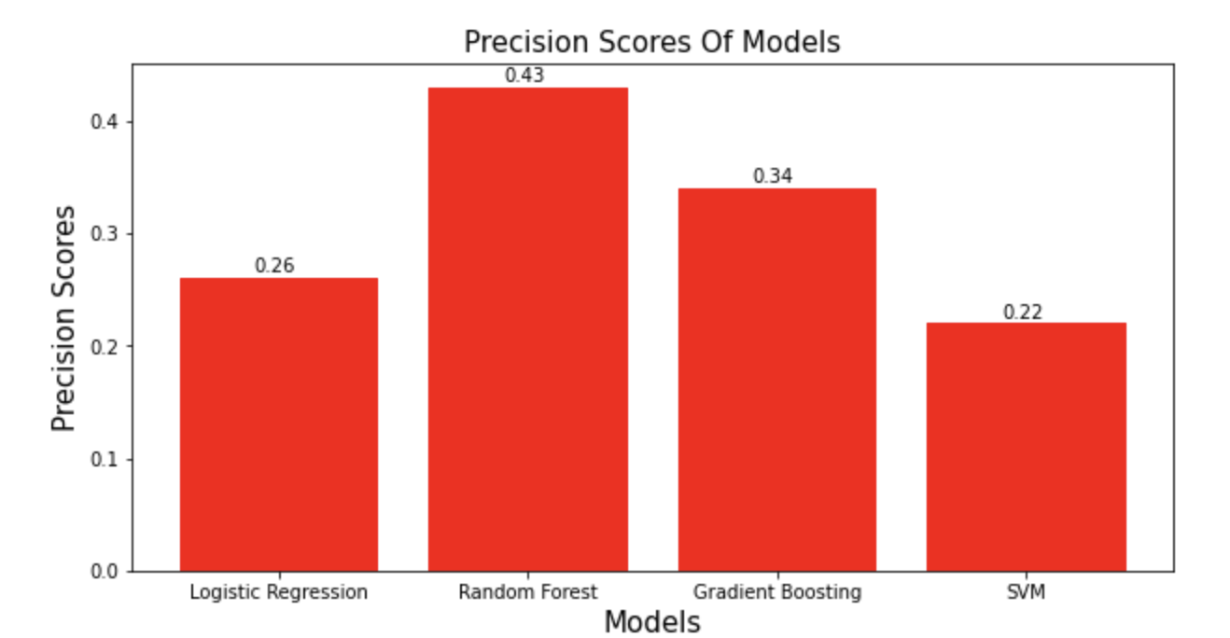
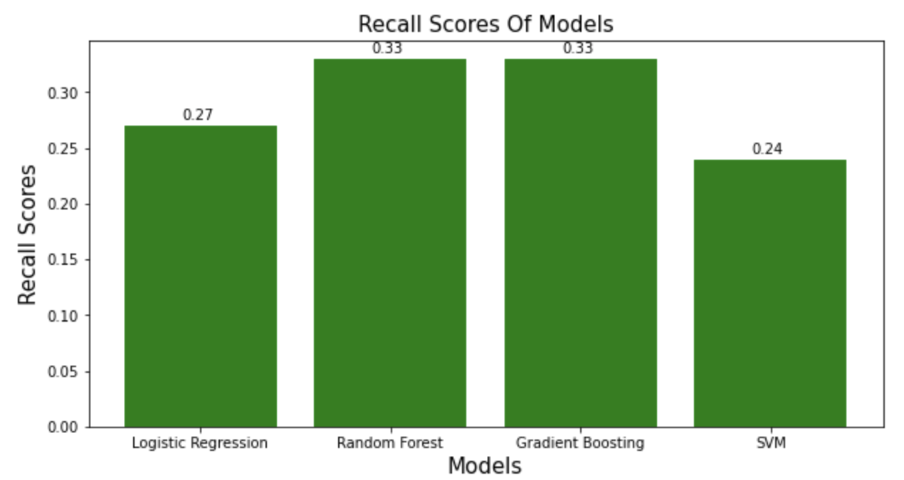
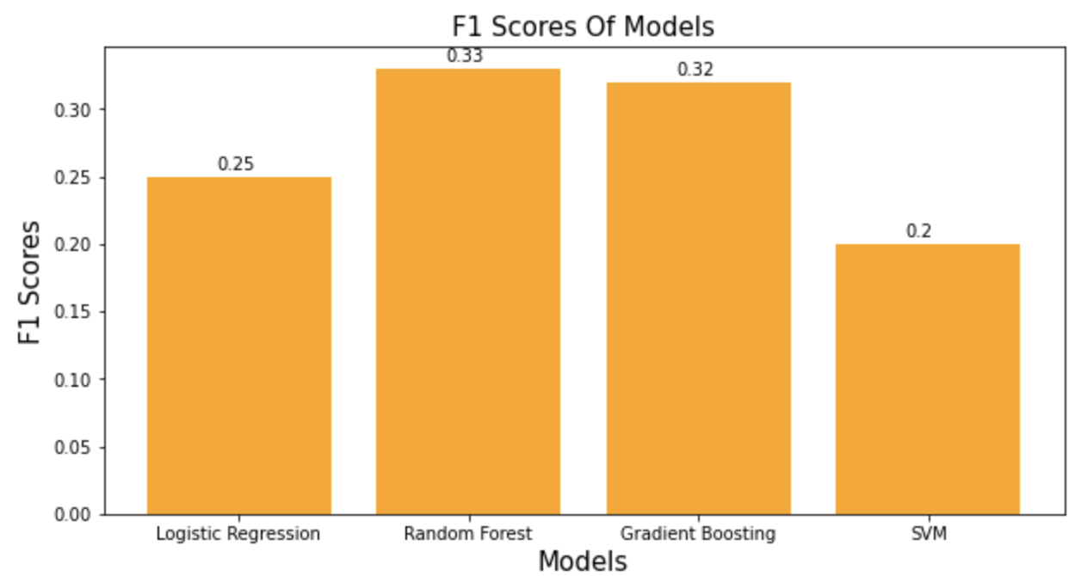
Models Comparison
The accuracy, precision, recall, and F1 scores are compared for all 4 models.
The delta between the best and worst model in accuracy: 1%, precision: 9%, recall: 9%, f1: 13%

Slide 9
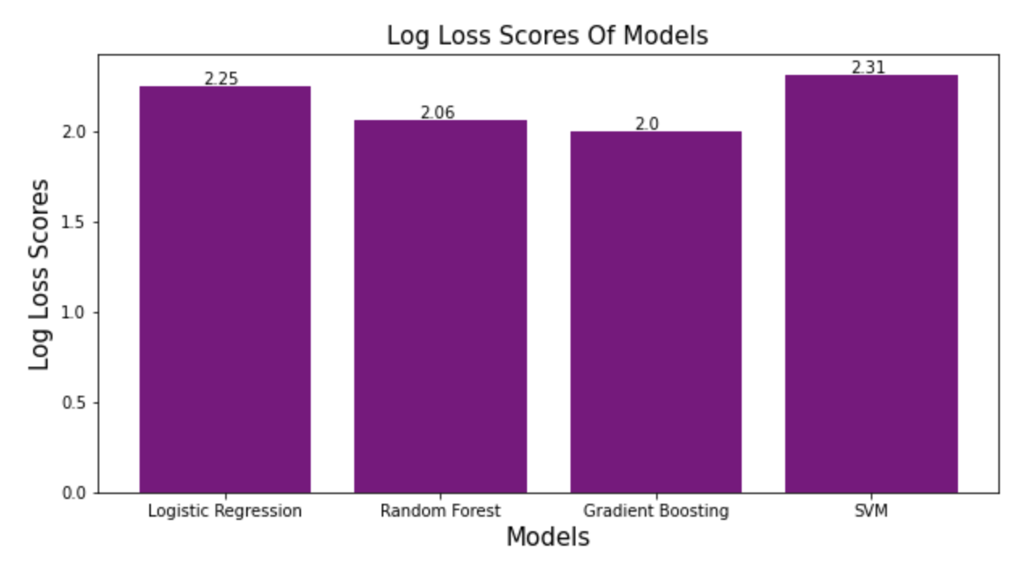
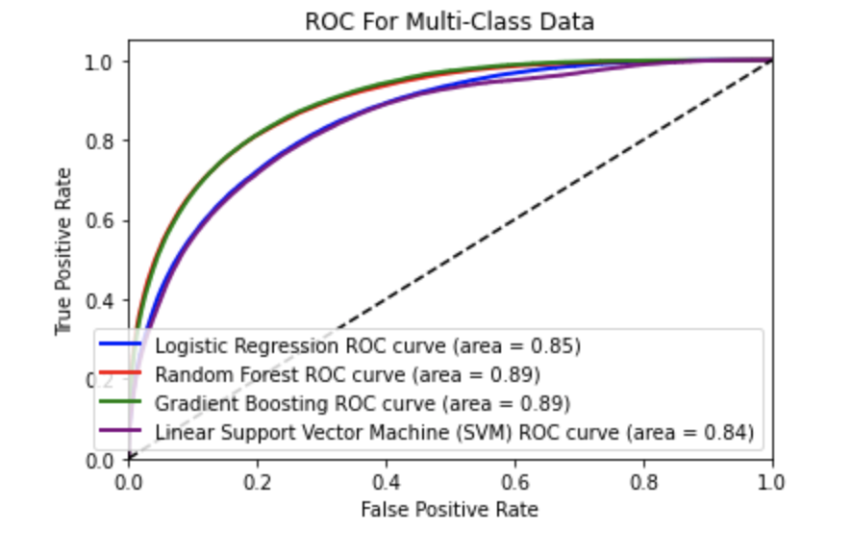
Models Comparison
The lowest Log Loss score was 2.0 for the Gradient Boosting Classifier model but the Random Forest Classifier model was close with a negligible 0.06 delta at 2.06.
The ROC curves and the area under the curve (AUC) is the largest at 0.89 for both the gradient boosting and random forest classifiers.

Slide 10
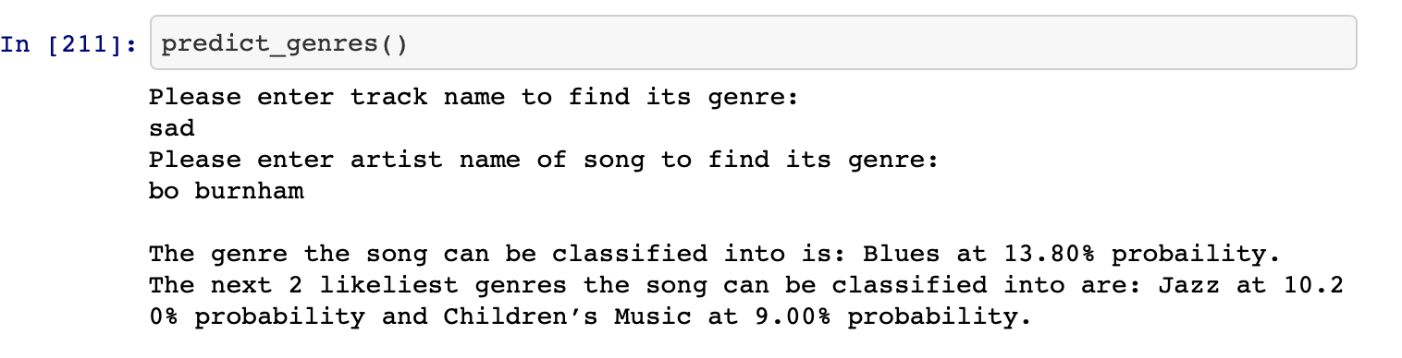
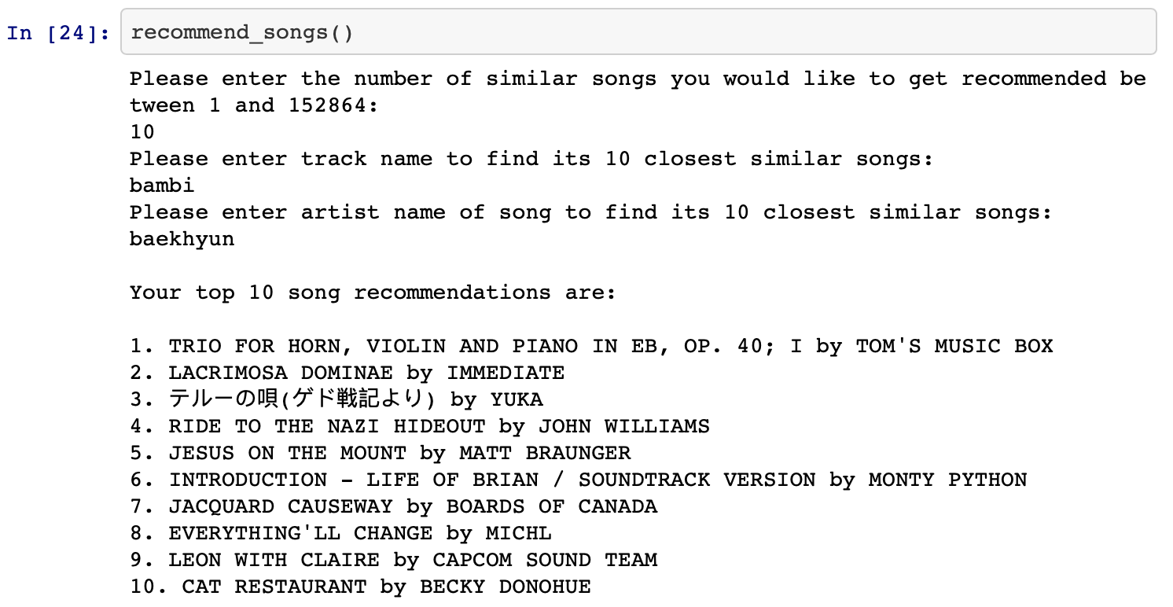
Genre Prediction & Similar Tracks Recommender Functions
I created a function that classifies song inputs from users into their predicted genre label and the next 2 most likely genres the song can be classified into in case Spotify decides to classify songs into more than one genre based on likelihood.
To accomplish this I built methods called ‘get_token(),’ ‘search_for_track(),’ ‘get_features(),’ and ‘predict_genres()’ to use the API and get the required audio features in cases where tracks inputted by a user don’t exist in the dataset.
Then, I used the random forest model to predict on the track and get the genre it predicts is the classification.
Lastly, I use the ‘predict_proba()’ method to get the likelihood of classification into the different genres and display the top 2 likelist ones after the actual predicted genre label.
I created a function that recommends the top K (user inputted integer K) songs similar to the one the user inputs that the user might want to listen to.
I asked for the inputs of artist name and track name as well as the k number of songs they want recommended to them.
To accomplish this I mimicked the KNN (K-Nearest Neighbor) algorithm by finding the euclidean distance of each of the inputted track’s features with every other songs features in the dataset and recommending the top k songs in order of smallest euclidean distance.

Slide 11
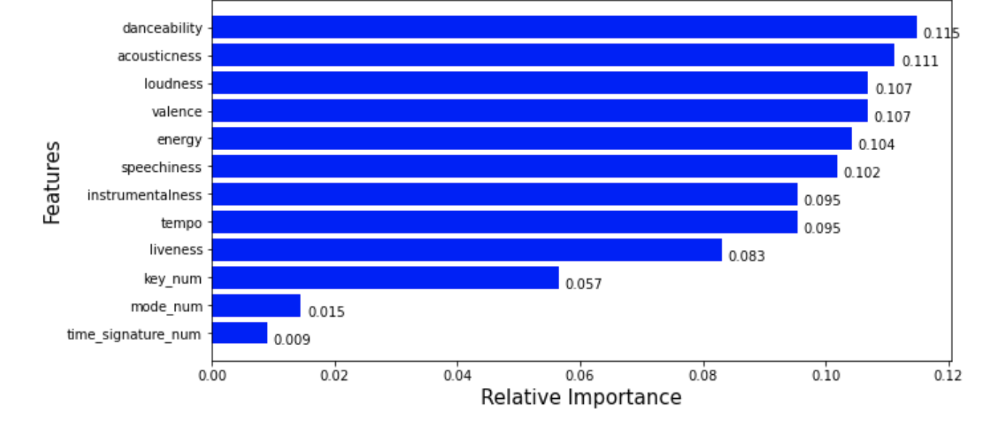
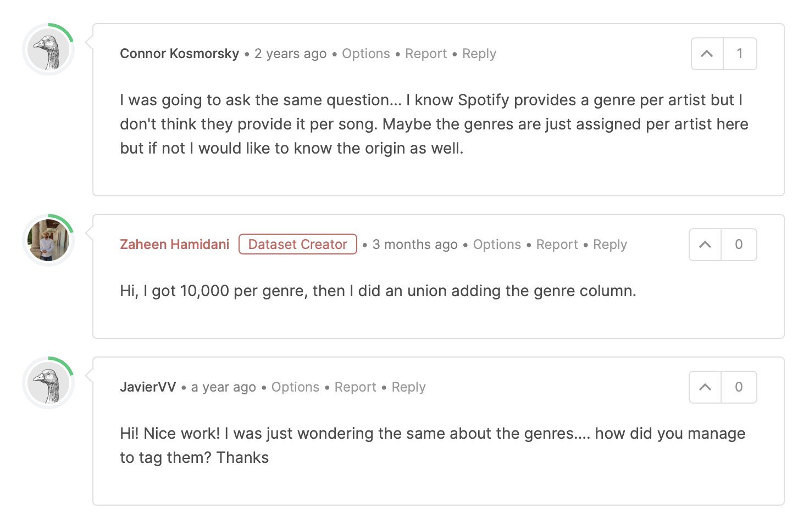
Takeaways
The random forest classifier was the best model although the gradient boosting classifier was also very close in performance with a 0.06 lower log loss score but was 7% less in precision than the random forest classifier.
Based on the displayed feature importances horizontal bar graph, the three categorical variables seem to not be very useful in training the model.
There is a possibility that the tracks have not been accurately labeled as this dataset was compiled by a kaggle user who didn’t explain the method by which they were able to label all the tracks.
‘Garbage in, garbage out’ could possibly be an accurate saying to represent the reason for the lack of an accurately created model.
Further experimentation and testing would be necessary to come to this conclusion of whether the data is intrinsically problematic and needs further feature engineering or the data compilation by the creator of the dataset is the issue.

Slide 12

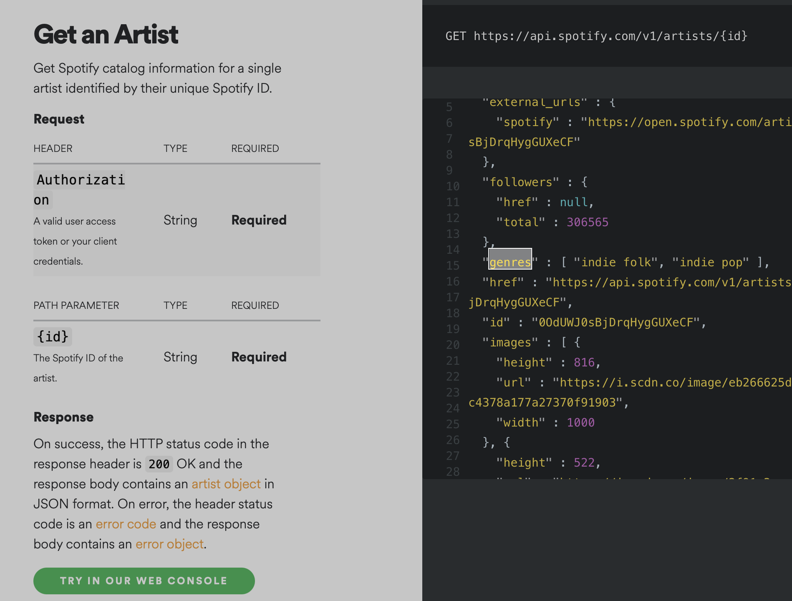
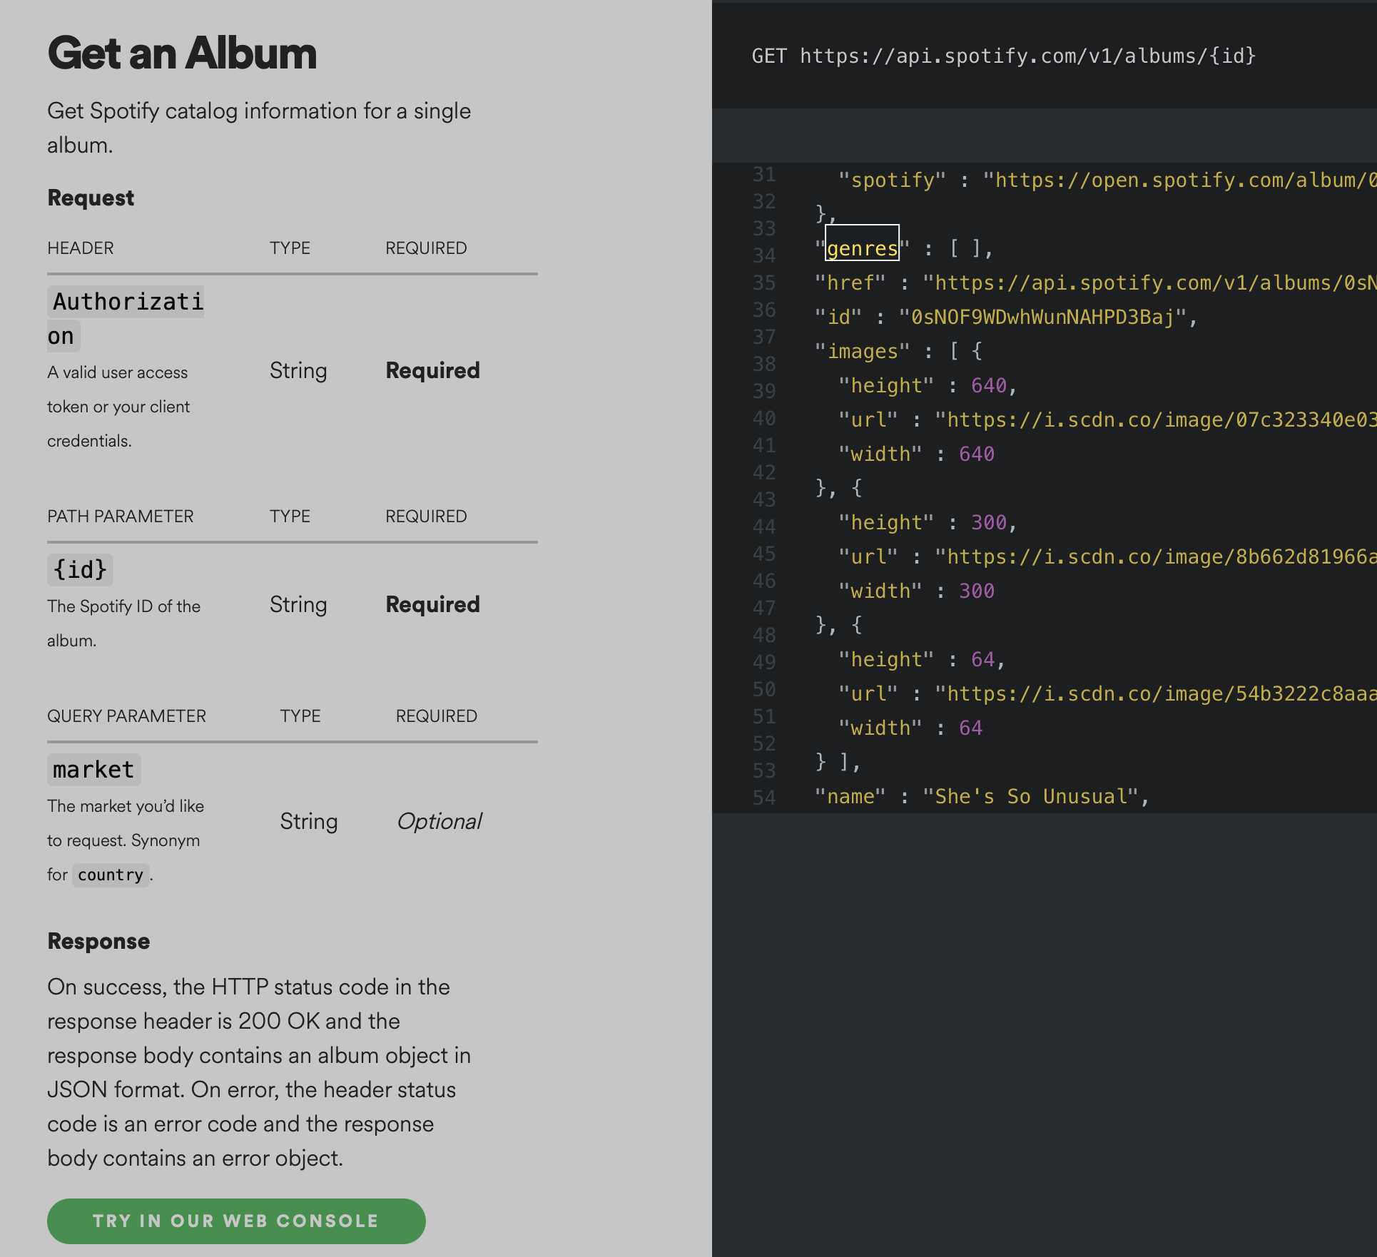
Further Research
In the future, I would like to eliminate outliers for each genre grouped by its associated features and see the results of refitting the model with the filtered data. As seen in the EDA step there were many outliers that could potentially have significantly hurt the fit of the random forest classifier.
Another thing to try would be to try and use different binning of features to see if that could help differentiate the genres more from one another.
This binning could be done with grouping the categorical variables such as keys (ex. C and C#, etc.) or even certain ranges of numerical features could be taken together to represent certain integer values.
Trying different binning techniques would allow us to see what leads to more distinct stratification of data between genres.
The third thing to try would be to compile the dataset myself by accessing the API and getting genres based on artist and album and synthesizing them in a way that would lead to more accurate pre-labeled data to use to train the model.
I already tried to look at genres based on tracks which don't exist, and I similarly couldn’t find genre labels for albums as well.
Maybe the genre labels for albums are rare in the Spotify database but there seems to be some genre labels for artists. Although using artist overall genre labels might seem improper when constructing a dataset, only further testing will determine how accurate it could be.

Slide 13
Thank You

